Slide 1
Wines Across the World
Sandeep, Jason, and Carter

Slide 2


Motivation and Summary
Goal:
Our project goal is to allow visitors to our site to explore relationships between wine varieties, ratings, prices, and countries
Example Questions:
How do wine brands vary across key attributes/factors (price, score, etc.)?
Where are the most wines are produced?
Where is the user’s favorite type of wine most frequently made?
Data Sources:
Kaggle & Wine Enthusiast

Slide 3
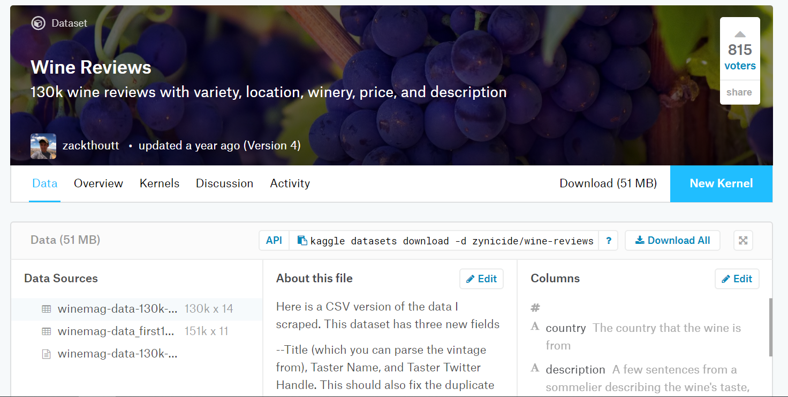
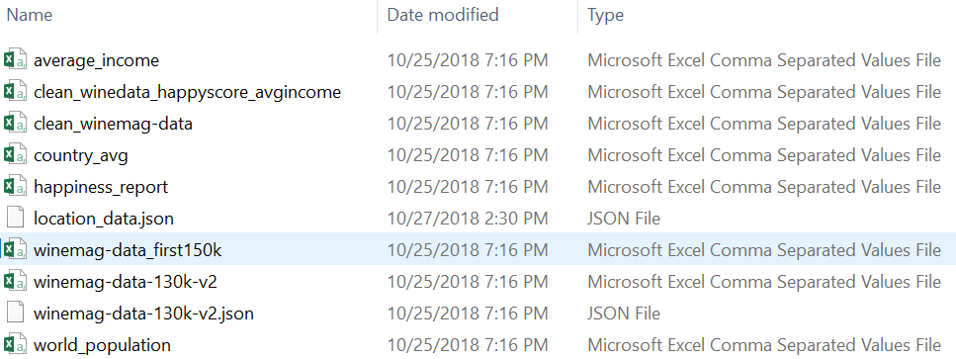
Data Cleanup & Exploration
Wine Review & Country Exploration
Multiple CSVs and an API
User-friendly site (Kaggle)
Data Files Obtained
130k unique rows of Wine Enthusiast reviews from late 2017
Country level demographic and sociographic statistics
Cleanup
Removed extraneous columns
Removed rows with missing data
Problems
Cleaning resulted in a significant reduction in rows (130k-80k)

Slide 4
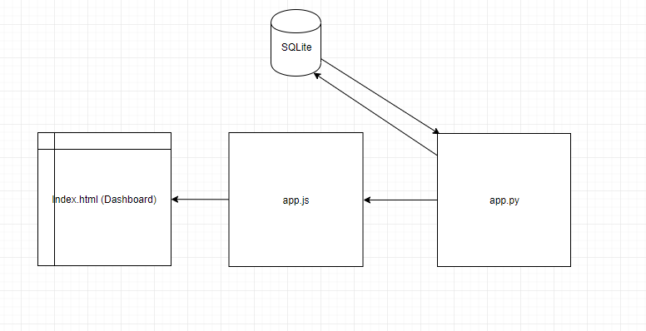
Coding Approach & Architecture
3 data exploration pages with 5 different interactive visualizations driven by HTML/JS/Flask and associated packages
Data and app architecture

Slide 5
Demo

Slide 6
Appendix

Slide 7
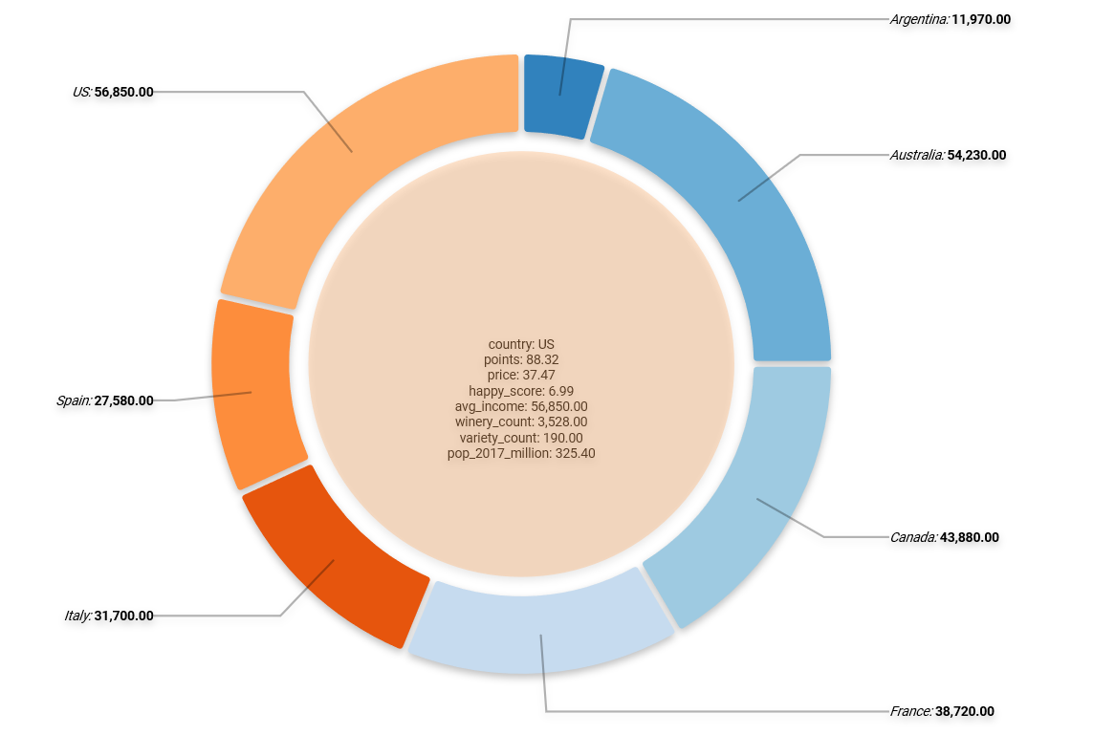
Country Wine Production & Associated Summary Statistics

Slide 8
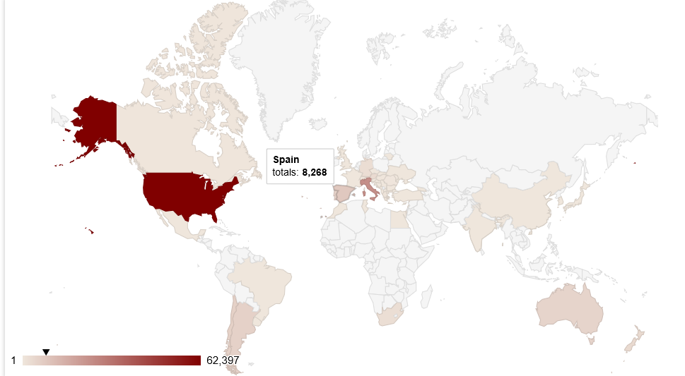
Map with Country Level Production (color scale = wine count)

Slide 9
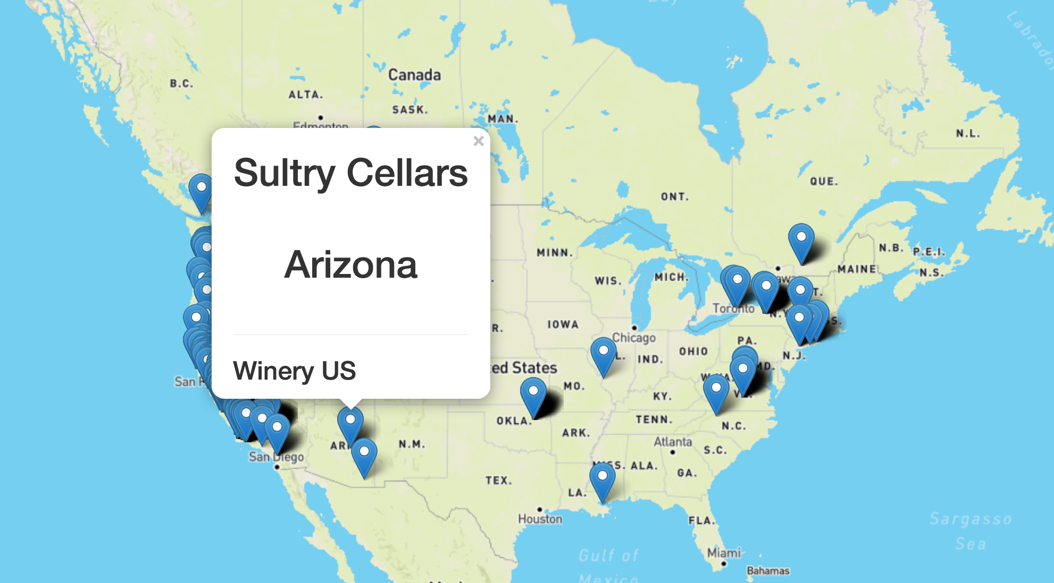
Map with Winery Locations (flag=winery)

Slide 10
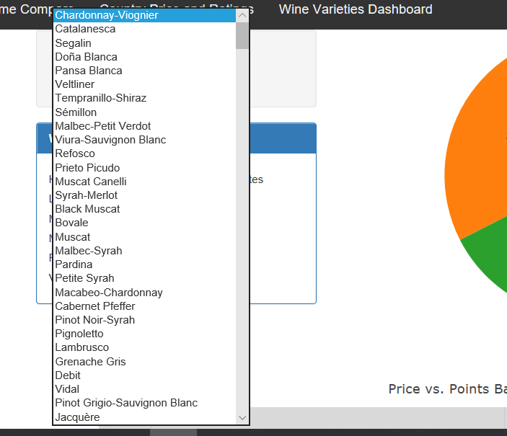
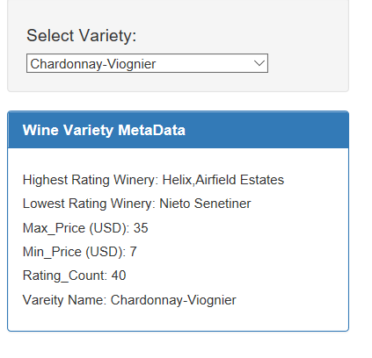
Wine Variety Dashboard: Dropdown & Metadata

Slide 11
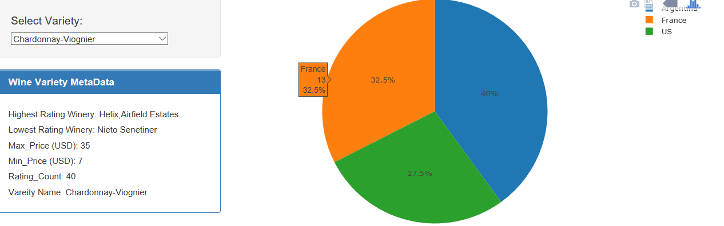
Wine Variety Dashboard: Country Production by Variety

Slide 12
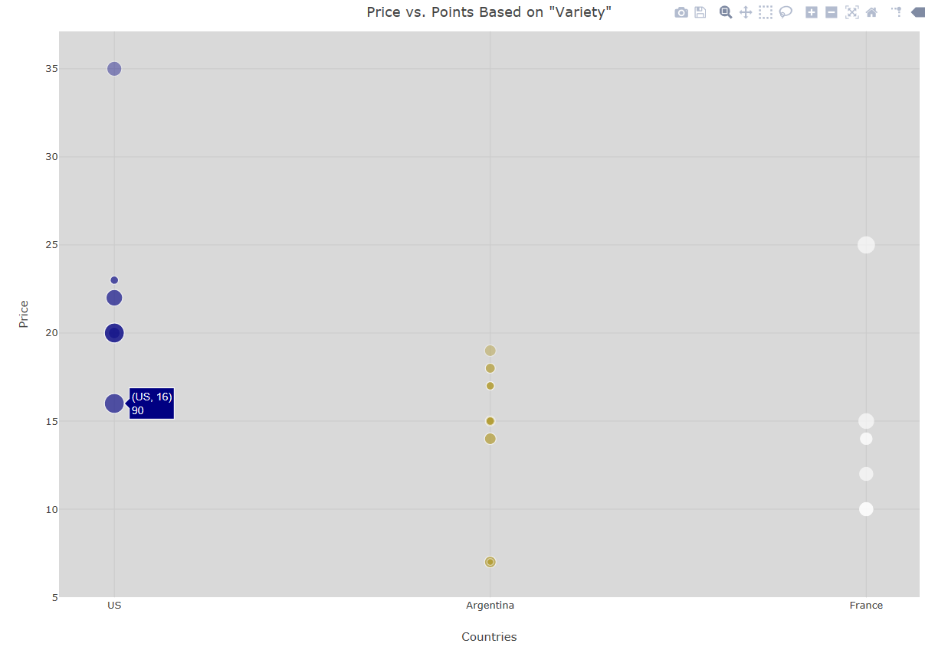
Wine Variety Dashboard: Price and Ratings of Wine Variety by Country

